Slide 1

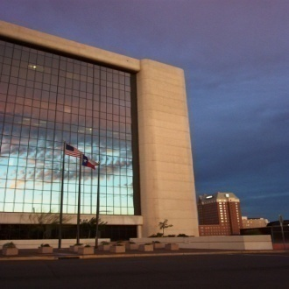


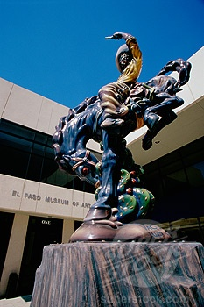

City of El Paso
Special Election to Fill Vacancies in Municipal Court No. 4 and City Council District No. 6
City Attorney’s Office

Slide 2
Texas Constitution
Article XI, Section 11(a) allows a home rule city to provide by Charter or Charter Amendment for a term of office longer than 2 years, but not to exceed 4 years, provided however, that such officers are subject to Article XVI, Section 65(b) of the constitution providing for automatic resignation in certain circumstances.
Article XVI, Section 65(b) states that if any of the officers shall announce their candidacy, or shall in fact become a candidate, in any General, Special, or Primary Election when the unexpired term of office then held shall exceed one year and 30 days, such announcement of candidacy shall constitute an automatic resignation of the office held.

Slide 3
Texas Constitution
Article XVI, Section 17 states that all officers within the State shall continue to perform the duties of their offices until their successor shall be duly qualified.
The Texas Attorney General has found that the “holdover provision” applies to automatic resignations triggered by Article XVI, Section 65 and Article XI, Section 11 of the Texas Constitution. Tex. Atty. Gen. Op. No. DM-377 (1996); Tex. Atty. Gen. Op. No. JC-0318 (2000)
Article XI, Section 11(c) requires a municipality with terms of office exceeding 2 years to elect all members of the governing body and any vacancies may not be filled by appointment but must be filled by a majority of qualified voters at a special election called for such purpose within 120 days after the vacancy occurs.

Slide 4
Texas Election Code
If an election is held within the 120 period it does not have to be held on a uniform election date nor does a city need permission from the Governor to hold the election on a non-uniform date. Texas Election Code section 41.004.
If a municipality misses the opportunity to hold the election within the 120 day period, the election must then be held on the next uniform election date unless the Governor grants permission for a special election. Texas Election Code Section 41.004.
Next uniform election date is May 10, 2014.
Section 41.001(d) of the Texas Election Code states that the County Elections administrator is NOT required to furnish election services on May of even numbered years.

Slide 5
El Paso Charter Amendment
Section 2.3 states that when a special election is required by a provision of this Charter, it will be scheduled for the
  Next uniform election date or
  The date of the next election that will be conducted by the County Elections Administrator

Slide 6
Potential Dates
Next uniform election date: May 10, 2014
  County is not legally obligated to furnish election services for this election
  Do not have the machines or staff to hold election
  County Election Administrator is declining to assist
July 19, 2014
  Will need permission from the governor
  County Election Administrator willing and able to enter into a contract to furnish election services
  Approximate cost to hold an election is $180K - $250K

Slide 7
Potential Dates (Continued)
November 4, 2014
  County will be obligated to enter into a contract to furnish election services
  Will be able to split the costs with other entities holding elections on that date
  Approximate cost to hold an election is $130K - $150K

Slide 8

Questions / Comments

